Slide 1
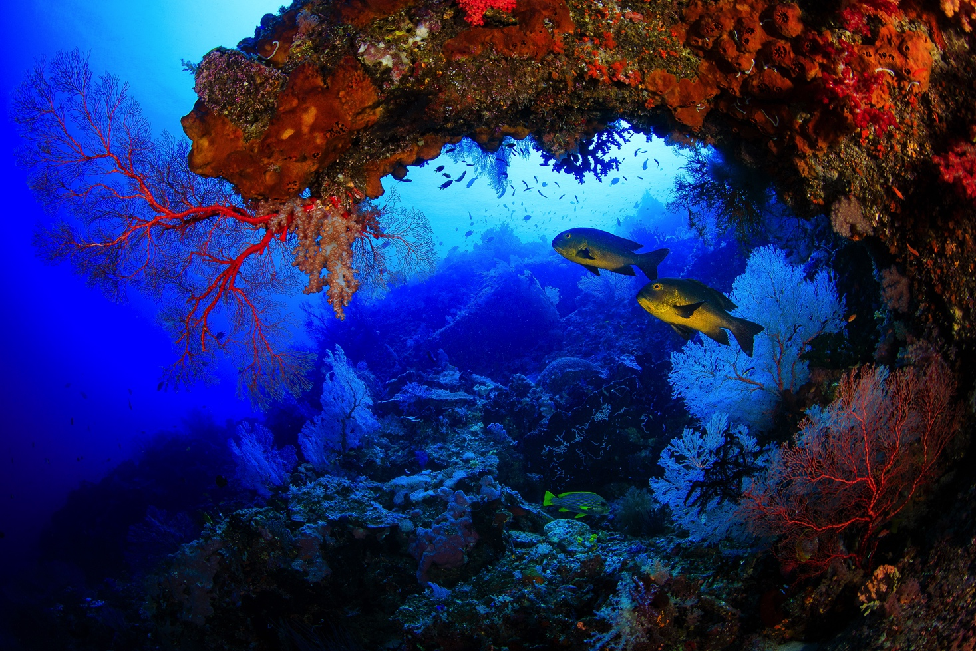
Finance Tools for Coral Reef Conservation: A Training Guide Green Taxes
Developed by the Conservation Finance Alliance and Wildlife Conservation Society for the International Coral Reef Initiative
Content drawn from Finance Tools for Coral Reef Conservation: A Guide (2018)
Venkat Iyer, Katy Mathias, David Meyers, Ray Victurine and Melissa Walsh
Funded with the support of the Government of Sweden
Photo: Yen-YiLee, Coral Reef Image Bank

Slide 2
Green Taxes - Overview
Definition: Excise taxes on environmental pollutants or on goods whose use produces such pollutants. Most taxes go to government treasury.
Value: ability to both generate revenue and align incentives to reduce harmful private actions.
Economic Model: addresses market failures due to externalities; allows the price of the product or service to reflect the environmental impact
Other names: “Environmental Taxes”, “Pollution Taxes”, “Eco Taxes”
Examples
Fuel / Carbon
Pesticides
Tourist Tax
Photo Courtesy of KATERINA KATOPIS
Notes:
One of the basic goals of a green tax is to reduce (or offset) the negative impact resulting from the use of non-green products and services due to those services being used less.
Pigouvian taxes;
Taxes that attempt to make the private parties involves feel the social burden of their actions
Economically speaking, green taxes go a long way in addressing the market failure that exists where the environmental (and sometimes human) damage related to the production and use of certain goods is not reflected in that goods price – the perception that generally these goods are under priced. The increase in price due to a green tax is an attempt at rectifying this.
Examples of this tax include a tax on cigarettes or general tabaco products, a fuel or carbon tax, or a tax on pesticides.
However, one must be careful to not institute green taxes that place a disproportionately large burden on the poor – green taxes can be designed to either be progressive or regressive, and might require complementary corrective measures to the benefit of poor households

Slide 3
Green Taxes – How do they work?
While taxes primarily address market failures by increasing the price of pollution, they may also serve to help change consumption behaviors towards those that are more beneficial to the environment - e.g. consuming less fossil fuel or fewer plastic bags.
Key design considerations:
Price elasticity of the good – how sensitive are buyers to price?
Costs of implementation of the tax – do revenues justify costs?
Tax rate – should be set according to objectives (i.e. raise revenue/change behavior)
Size of the tax base
Impact of the tax on individuals – issues of equity and fairness.
‘Earmarking’ of funds
Photo Courtesy of KATERINA KATOPIS
Notes:
Green Taxes serve three main functions;
They serve to alleviate the market failure present, and seek to address the externalities that result from the under-valuation of natural systems and resources
They serve to help change consumption behaviors towards behaviors that are more beneficial to the environment and biodiversity
They serve to generate revenues that can be funneled back into conservation activities
There are several factors that must be considered when designing a tax
Price elasticity of the good
How much the demand will change when the price changes. A good with a high elasticity will see a dramatic change in demand as the price changes; a good with low (or no) elasticity will see little to no change in demand as the price changes
Costs of implementation of the tax
This will vary depending on whether or not green taxes already exist in some form or another, and the current political climate and context surrounding the introduction of the green tax itself
Tax Rate
The tax rate is very important as it can impact the elasticity of the good or action. If the goal of the tax is to simply generate revenues, then perhaps a high tax rate is not necessary in order to generate the desired amount of revenues. However, if the goal of the tax is to change behavior, then the tax rate may be required to be a significant amount in order to change consumption habits. The tax rate can also be changed over time if it is deemed too small or large.
Size of the tax base
The size of the tax base will determine in many ways how much capital the tax will generate, and how much of that capital will be funneled back into conservation efforts.
Impact of the tax on individuals
An environmental tax may impact different segments of the population in different ways. A steep fuel tax, for example, will negatively impact the rural poor who rely on farming equipment or other vehicles as their primary means of transportation. Urban elites, who do not use vehicles for work or to travel (for example those who use public transportation), will be less impacted by this tax even though they are in a stronger financial position to bear the burden of the tax. Tourist taxes can be especially politically favorable because they are (usually) paid by non-citizens
The revenues from these environmental taxes can be directed towards designated environmental trust funds to ensure that the use of the newly acquired financing is focused around environmental protection. Often times the revenues that are generated from such tax schemes are cycled back into the general governmental budget and are not used specifically for conservation. This practice is called “earmarking”
However, it must be noted that earmarking fixes the revenue which may create an obstacle for the re-evaluation and modifications of the tax and spending programs. Therefore, the economic and environmental rationale for any earmarking should be evaluated regularly to avoid inefficient spending that would otherwise not be financed from general tax revenues.

Slide 4
Elements of Green Taxes
Households and Companies
Supply Chain and Wholesalers
Decrease in harmful products and money for budget
Government, Treasury
Economic Model: Polluter pays principle, Pigouvian Taxes
Annual or revenue-based payments
Price Changes
National Budget
Green Taxes

Slide 5
Green Taxes – Conservation Activity Relevance
Earmarked taxes can help finance the management and operational costs of Marine Protected Areas
Can also be used to deter harmful activities from occurring in high frequency (i.e. pollution)
Can encourage the development of sustainable fisheries and restoration of coral ecosystems
Green taxes can simultaneously alleviate harmful external influences on coral ecosystems while also generating revenue that be used to extend protected areas within which reefs reside
Photo Courtesy of KATERINA KATOPIS

Slide 6
Green Taxes – Stakeholders
Government
Regulatory Entities
Revenue Collection entities
Tax base/payer
Photo courtesy of: The Ocean Agency
Notes:
The stakeholders are as follows:
Government:
Strong leadership is needed to promote green fiscal reforms, and to ensure that ministries across government understand their importance for human health and the environment
Regulatory entities:
The ministry of finance or the government authority responsible for the management of ta revenue drafts the relevant bill for approval in the national/regional assembly
Revenue collection entities:
The tax is collected by the revenue authority, from importers, producers, wholesalers and/or retailers. The revenue might be transferred to the Treasury or allocated to a specified budget (health promotion programmes, coral reef research)
Tax base/Payer:
The tax base is the sales of pesticides/fertilizers. The tax liability is typically borne by manufacturers or importers, with costs transferred to local consumers or companies

Slide 7
Green Taxes – Feasibility Assessment
Are mechanisms in place to allow for the introduction of new taxes or the amendment of the tax code?
Is there a clear understanding of the negative inputs threatening the environment and how taxes, or the revenues from the taxes, will benefit the ecosystem?
Have assessments been made concerning the impact of the tax on all stakeholders?
Are there existing structures and systems in place to collect tax revenue, and has the potential for leakage been evaluated?
Photo courtesy of: The Ocean Agency
Notes:
A law is usually required to introduce or amend the tax code. In federal states different jurisdictions can also introduce taxes. Feasibility studies are necessary to forecast the economic, social and environmental impact of the tax in question. A cost-benefit analysis, versus alternative measures, (for example regulatory provisions on toxic content), should always be considered. Collection of scientific evidence over the impact of harmful actions on ecosystems as well as related risk assessments on environmental and human health effects is required to inform the design of the tax. An assessment of the impacts of the tax on all stakeholders and in particular vulnerable groups should be included in the feasibility phase.

Slide 8
Green Taxes – Revenue Potential
The revenue can vary widely. Factors impacting the revenue include the how broadly the tax is applied, the tax base, and the tax rate.
Examples of revenues of Green Taxes:
France: 60M EUR on a tax on pesticides (estimated for 2012-2013
China: 11B USD generated in 2015 alone on a tax of 11% on tobacco products
Photo courtesy of: The Ocean Agency
Notes:
The revenue potential depends entirely on the consumption of the good that is the target of the tax, as well as the tax rate and how comprehensive the tax is (how many products the tax is applied to)
Examples of revenues of Green Taxes:
France; 60million euros from 2012 to 2013 on a pesticide tax
China; 11 billion dollars in 2015 alone on a tax of 11% on tobacco products

Slide 9
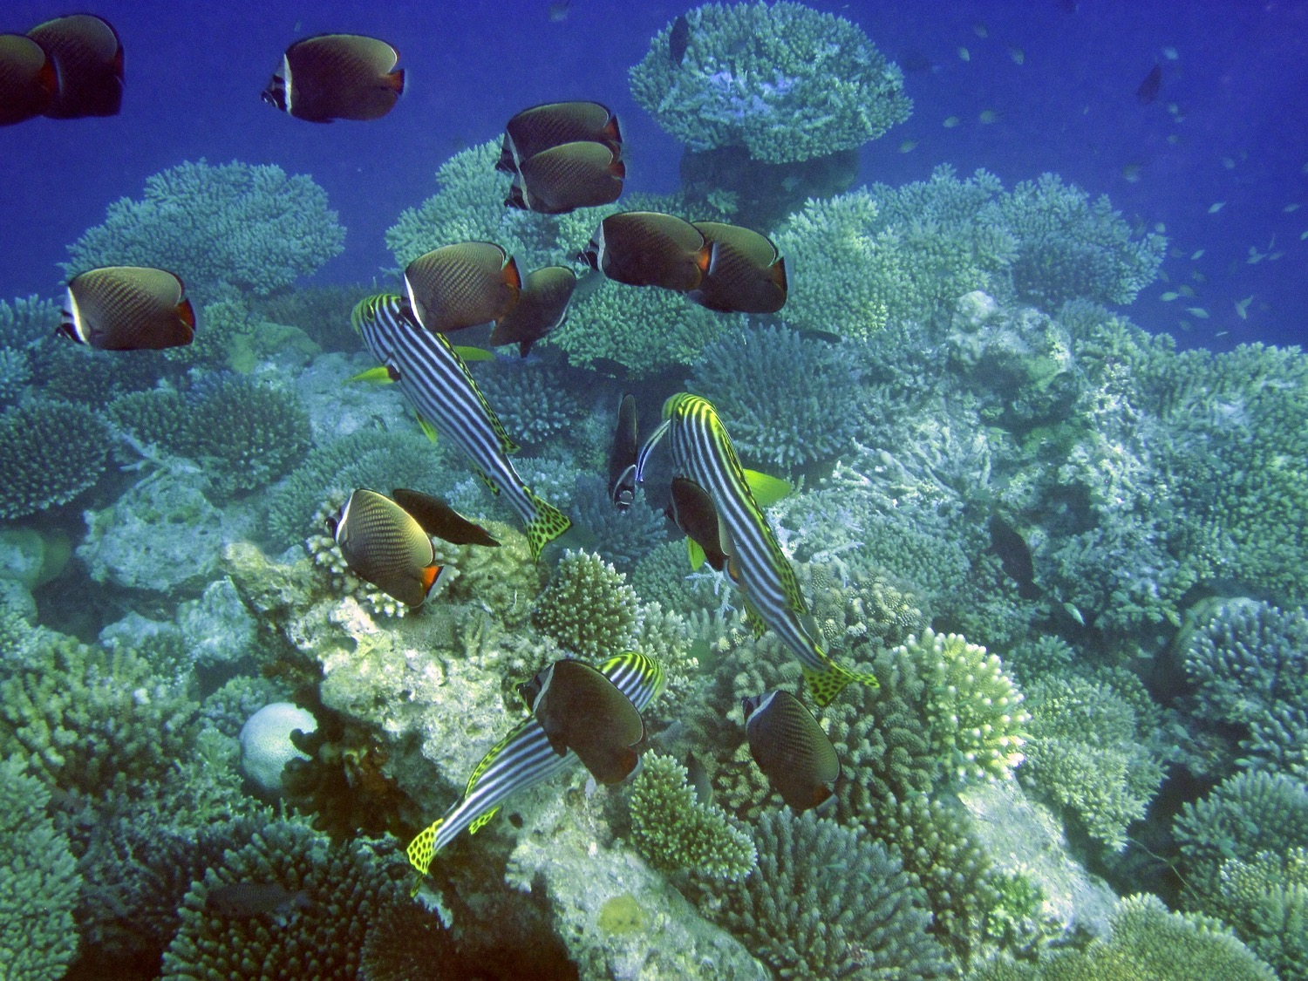
Green Taxes – Case Study: Maldives Green Tax
Maldives introduced a green tax in 2009
Tax is levied on tourists who stay in resorts, hotels, and guesthouses, and on tourist vessels - $6/day ($3/day for guesthouses)
Goal was to raise funding to mitigate impact of climate change and rising sea levels
Roughly 25% of the Maldives’ GDP came from tourism
Local criticism is that the use of tax revenue is not sufficiently tied to environmental programs
Photo courtesy of: The Ocean Agency
Photo Courtesy of Rick COGLEY

Slide 10
Green Taxes – Case Study; Belize
Belize charges a conservation fee of $3.75 USD for overnight visitors and a 15% per head commission on cruise ship passengers
The proceeds go directly to PACT Belize, a Conservation Trust Fund established to manage and distribute the funds specifically for conservation purposes
The use of the CTF to distribute the proceeds ensures the funds go conservation efforts in Belize’s PAs through grant-making programs
Photo Courtesy of Connor HOlland
Photo Courtesy of KATERINA KATOPIS

Slide 11
Green Taxes – Case Study
Tax on Diffuse Agricultural Pollution FRANCE (2008)
Under the law on water and the freshwater environment (loi sur l’eau et les milieu aquatiques)
7 water taxes were introduced – including tax on diffuse pollution, which was levied on the sale of pesticides
Tax rate varied according to toxicity of the substance
Final tax rate for most toxic substances only amounts to around 5% to 6% of the sale price
Tax was increased 2-3 times over the course of several years
Photo Courtesy of KATERINA KATOPIS

Slide 12
Green Taxes – Case Study
Tax on Diffuse Agricultural Pollution FRANCE (2008)
Category of substance | Since 2011 tax rate (in EUR/tonne)
Substances which are very toxic, carcinogenic, mutagenic, or toxic to reproduction | 5.1
Substances which are hazardous for the environment | 2
Mineral chemicals which are hazardous for the environment | 0.9
Total revenue in 2014 from the tax was EUR 110M, and EUR 41M was channeled into a strategic plan to reduce country-wide pesticide use “Ecophyto Plan”
Note: the tax was not effective at reducing pesticide use.
Photo Courtesy of KATERINA KATOPIS

Slide 13
Green Taxes – Case Study
Tax on Diffuse Agricultural Pollution FRANCE (2008)
Category of substance | Since 2011 tax rate (in EUR/tonne)
Substances which are very toxic, carcinogenic, mutagenic, or toxic to reproduction | 5.1
Substances which are hazardous for the environment | 2
Mineral chemicals which are hazardous for the environment | 0.9
Total revenue in 2014 from the tax was EUR 110M, and EUR 41M was channeled into a strategic plan to reduce country-wide pesticide use “Ecophyto Plan”
Note: the tax was not effective at reducing pesticide use.
Photo Courtesy of KATERINA KATOPIS

