Slide 1
Using the Private Sector to help conserve and protect the planet's marine ecosystems
with main support from:

Slide 2
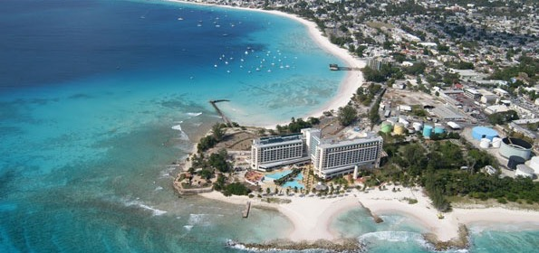
blue finance mission
Explore new ways of utilizing the business world for marine conservation, while staying true to the triple bottom line – environmental, social and financial returns.

Slide 3
blue finance activities
Structure and manage impact investments in marine conservation biodiversity
A suite of projects is being developed in the Eastern Caribbean (2016-2020)

Slide 4
Blue finance sites
Blue finance sites

Slide 5
Proposed Marine Management Area

Slide 6
THE Barbados marine management area
Combination of conservation, recreational and fishery areas
A total of 20 km² of marine areas in most densely populated coast
Objectives
Improvement of marine & coastal ecosystems
Become one of the main marine attractions for visitors
Co-managed by a public and private partnership through an operator

Slide 7
blue finance approach in barbados
In collaboration with national government and local stakeholders
Preparatory steps:
Value financing needs for the future Marine Managed Areas (MMAs):
Up-front investment US$2.5M (inc. water quality improvement and visitor attractions)
Operational costs: US$800k
Development of a business model attractive for investors based on improvement of marine biodiversity and ecosystem services (fish biomass, scenic beauty and coastal protection)
Bringing investors on board, local (hoteliers) and international

Slide 8
blue finance approach in barbados
Implementation
Develop the public-private partnership agreement to mandate private operator (NGO) to co-manage
Marketing plan with to “market” scenic beauty
Ensure returns on investment: financial, environmental and social performance indicators
Monitoring & Evaluation

Slide 9
blue finance approach in barbados
Invest into management
Increase natural capital
Create Blue Economy Return on Investment

Slide 10
Co-management model of the MMA
Ministry of Environment
Ministry of Tourism
Economic affairs
PPP agreement
MMA operator
Up-front investment
Operational costs
2 missions:
Conservation of nature
Enhancement of Tourism, Fishery and Coastal protection
Annual incomes from:
Tourism user fees
License fees
Payment for Ecosystem Services

Slide 11
co-managemenT
Activities | Operator | Government
Enforcement | (light)
Regulations
Environmental activities
Monitoring
Education
Marketing & tourism products
Maintenance

Slide 12
benefits from the agreement
All financial risks supported by the operator
Reduces public investment
Strict audit of the performances
Result-oriented management
Enhancement of the tourism reputation of the site

Slide 13
other successful experiences
Selection of MPAs/MMAs co-managed with private sector and self-sustaining through user fees:
The CHICOP eco-hotel in Zanzibar
The Misool Eco Resort in Indonesia
The SIMCA Marine Park in Sabah, Malaysia
The Whale Island Bay Resort, Vietnam
The National Marine Park in Bonaire
The Hol Chan Marine Reserve in Belize
The Soufriere Marine Management Area in St. Lucia
Many others not documented

Slide 14
challenges during the process
Financing gap size and business models robustness
Limited track record for private sector investing in marine biodiversity
Delegation of public sector responsibilities

Slide 15
Thank you

