Slide 1
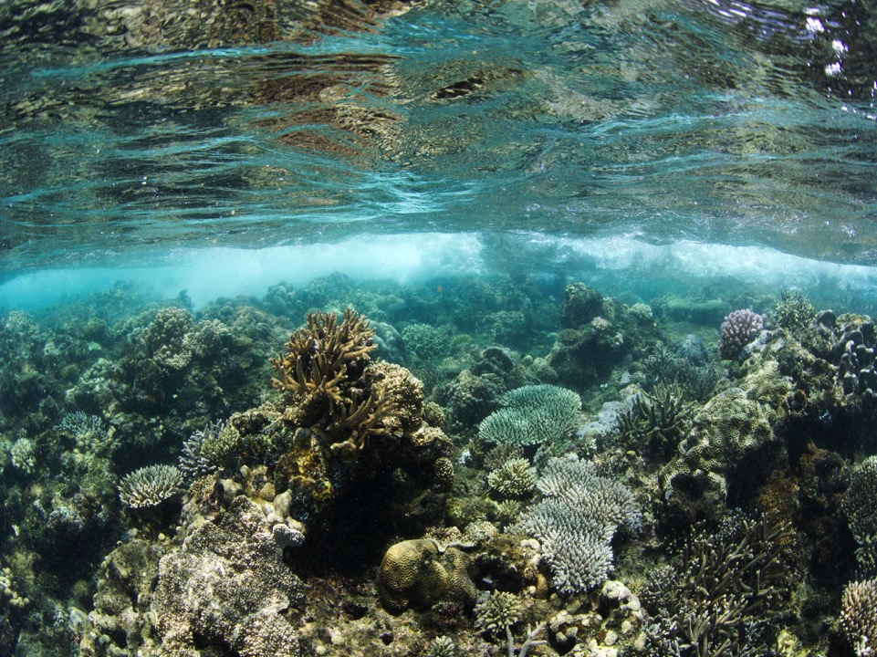
Blue Economy: Coral Reefs Matter From fisheries management to reef conservation
Experiences from the western Indian Ocean islands

Slide 2
Introduction

Slide 3
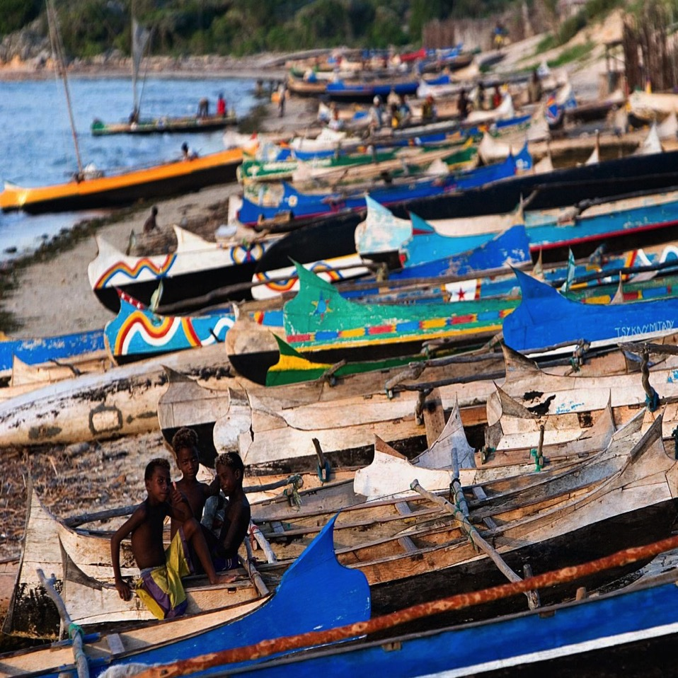
The Vezo
Notes:
The people of the southwest coastline are known as the vezo
The word vezo comes from the verb mive which means “to paddle” and highlights the inextriacable link that exists between the vezo and the ocean
Believed to be the grandchildren of the Mermaid Ampela mananisa, the vezo have a strong traditional, cultural and spiritual link to the ocean.
And because of the arid desert like conditions experienced in this area of madagascar - people rely on the ocean, for food, income, transport and their cultural identity

Slide 4
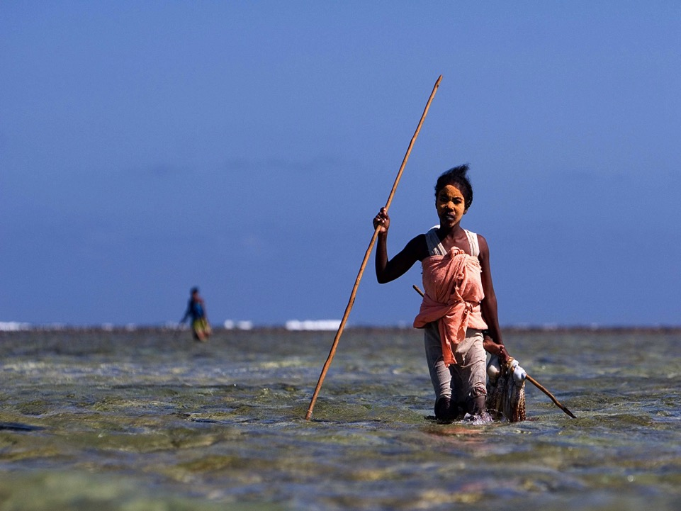
‘Small scale’ fishing

Slide 5
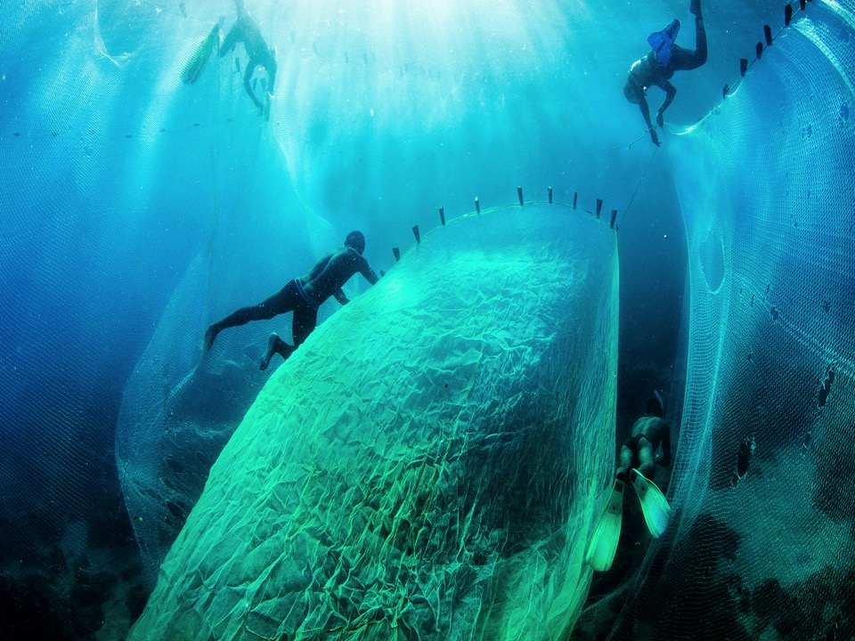
Multiple challenges

Slide 6
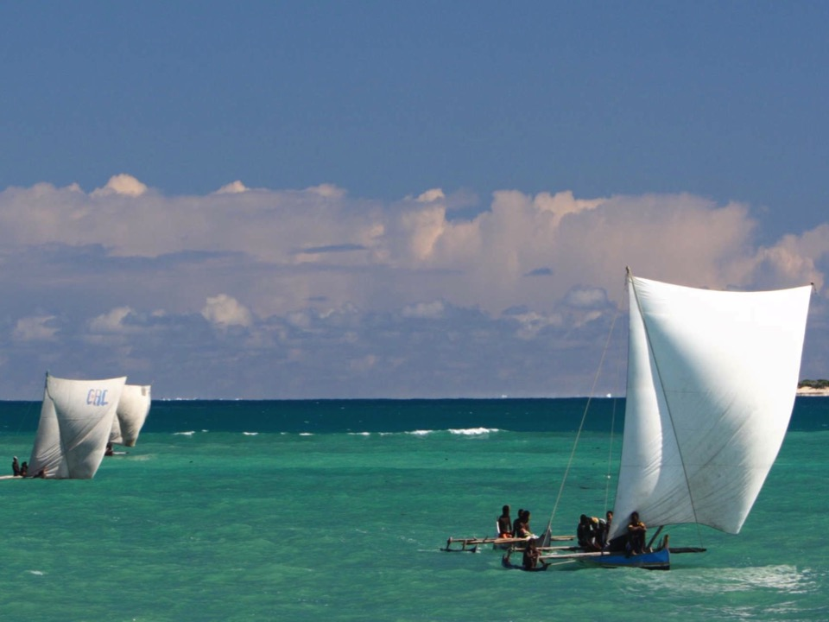
Traditional adaptation

Slide 7
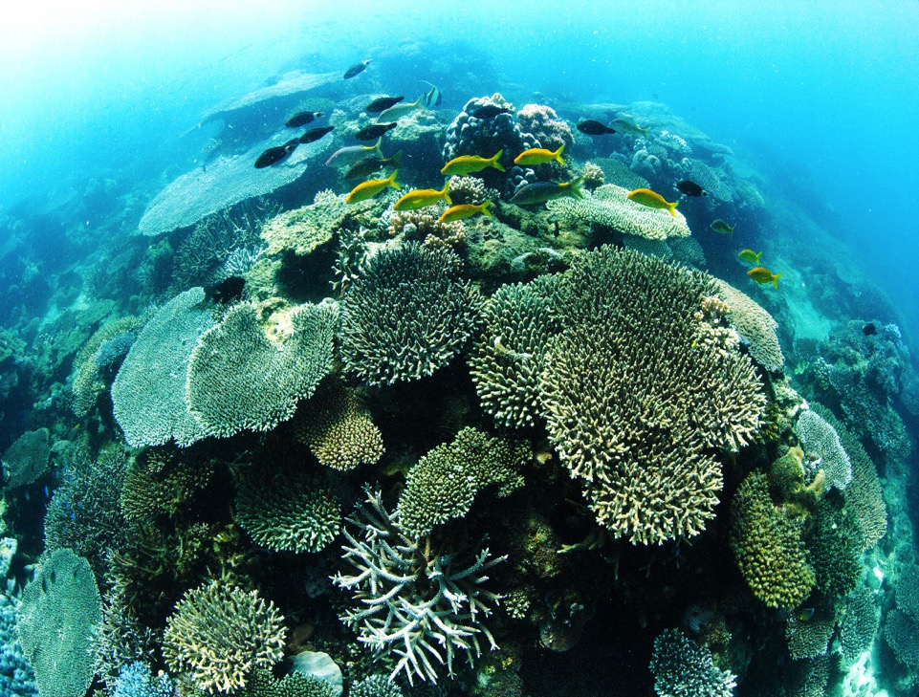
Conventional conservation

Slide 8
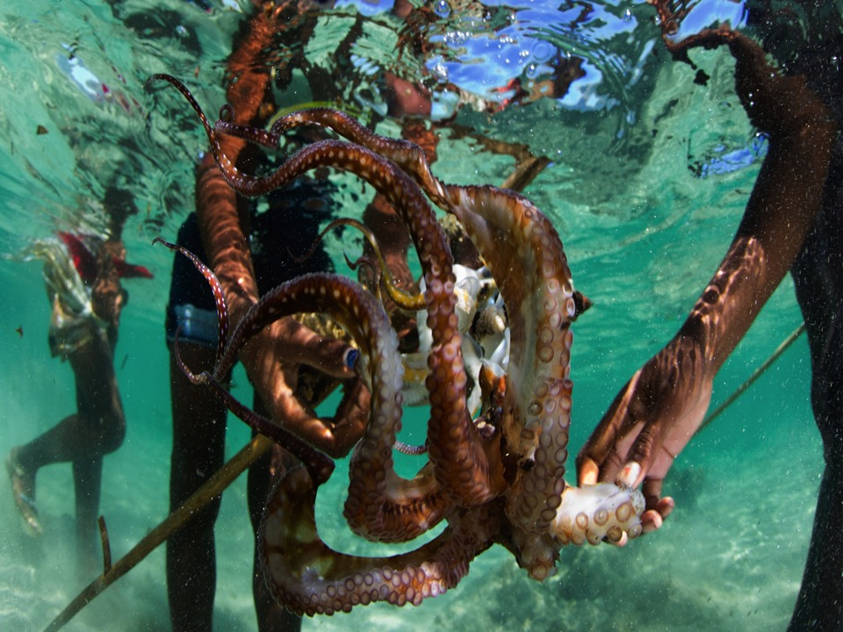
An eight legged ally

Slide 9
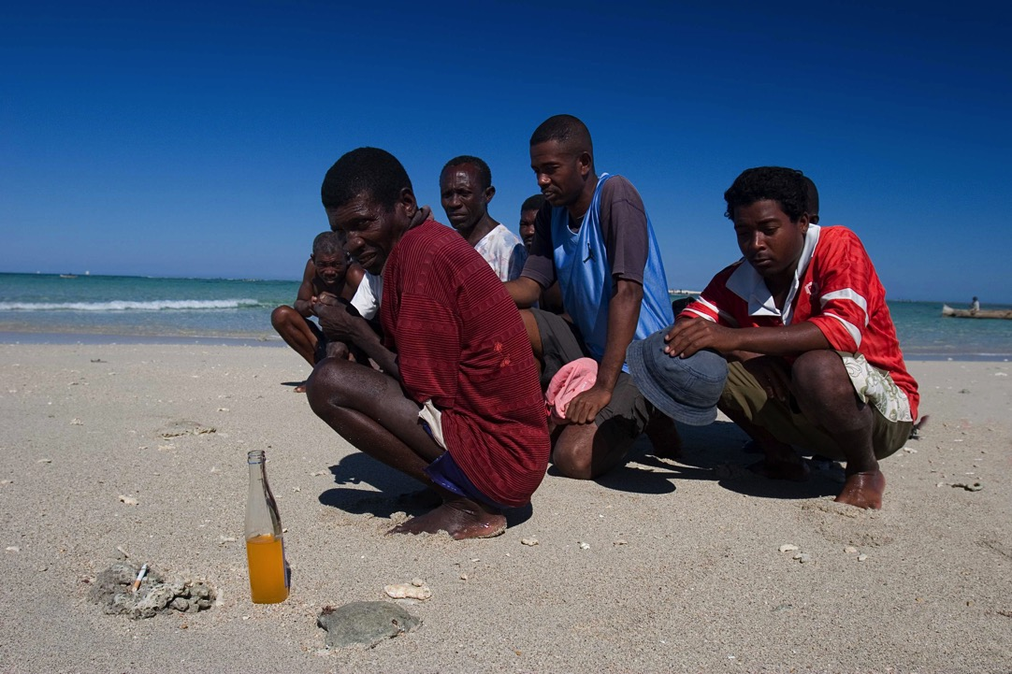
Dina

Slide 10
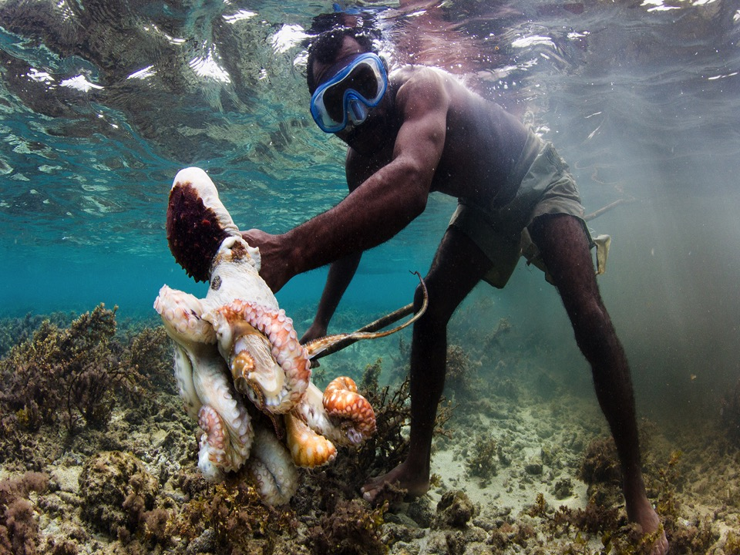
Improved catches

Slide 11
“The octopus fishery closure worked for me today – I caught the same amount that I used to be able to catch a long time ago, when I was young. To me, the closures allow me to save money. Tomorrow afternoon, I’ll go and buy a new pirogue hull.”
Madame Kakoly, fisher, Andavadoaka

Slide 12
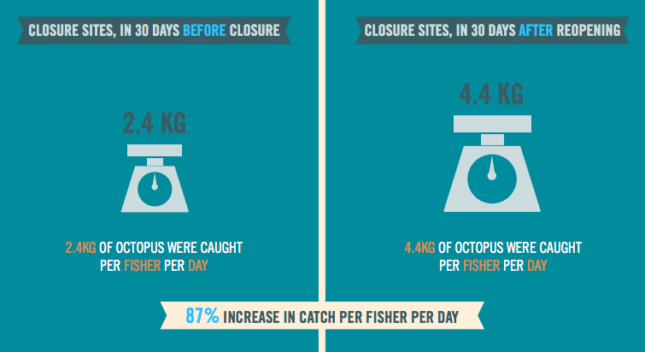
Oliver TA, Oleson KLL, Ratsimbazafy H, Raberinary D, Benbow S, et al. (2015) Positive Catch & Economic Benefits of Periodic Octopus Fishery Closures: Do Effective, Narrowly Targeted Actions ‘Catalyze’ Broader Management? PLoS ONE 10(6): e0129075. doi: 10.1371/journal.pone.0129075

Slide 13
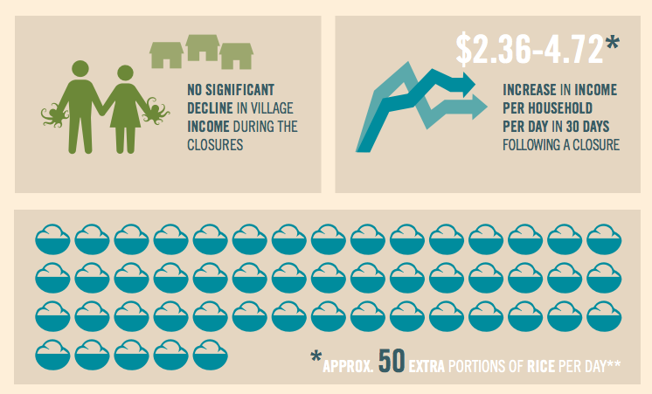
For more information on this study go to
https://discover.blueventures.org/marine-management-pays/

Slide 14
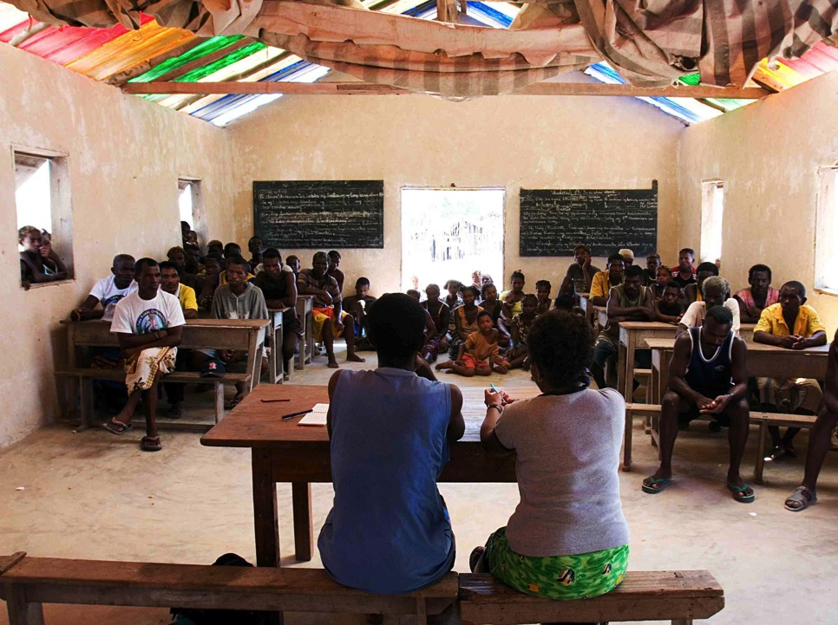
Community conservation

Slide 15
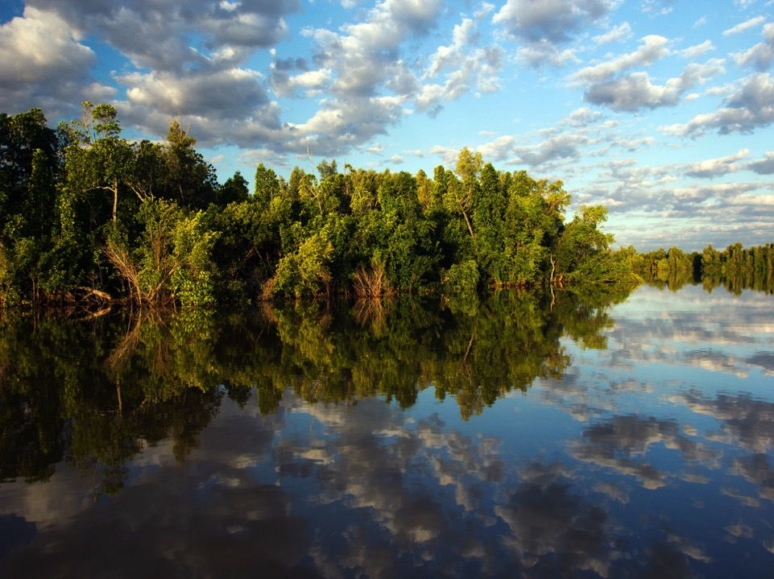

Slide 16
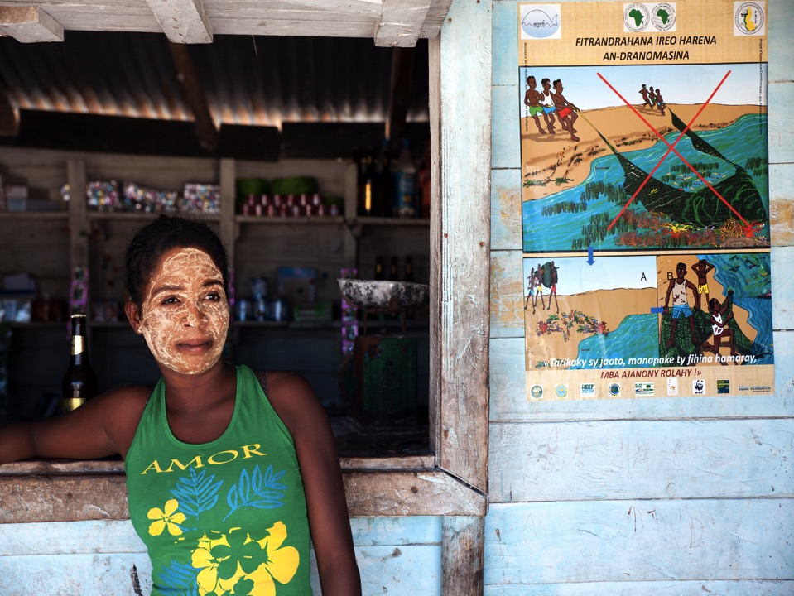

Slide 17
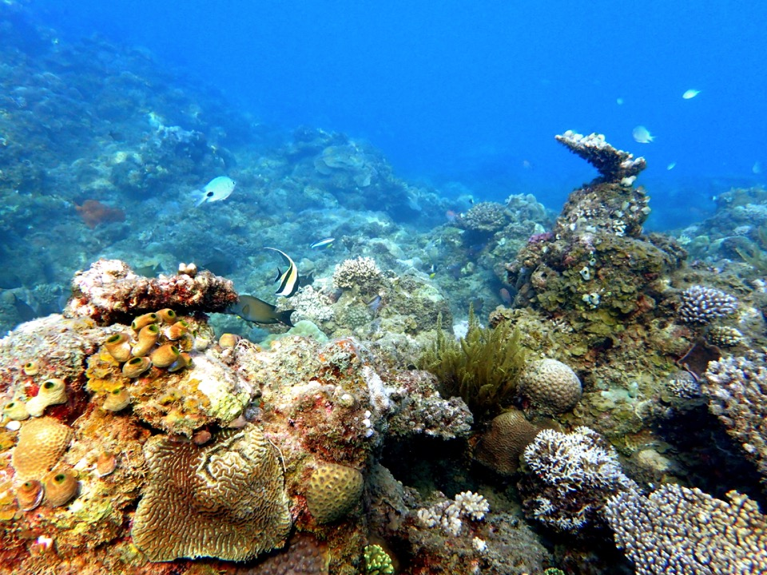

Slide 18
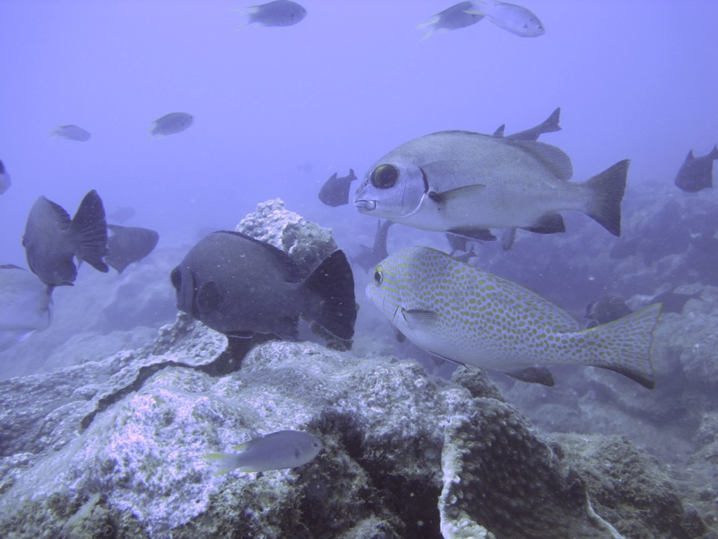
Increased biomass

Slide 19
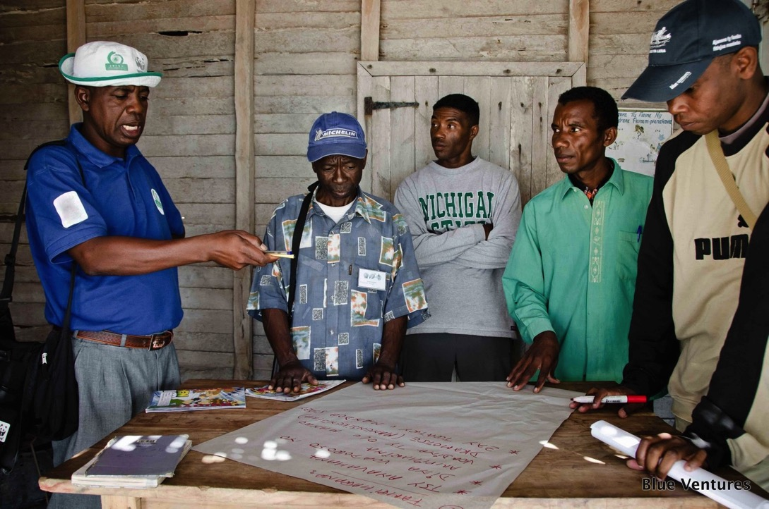
Sharing experiences

Slide 20
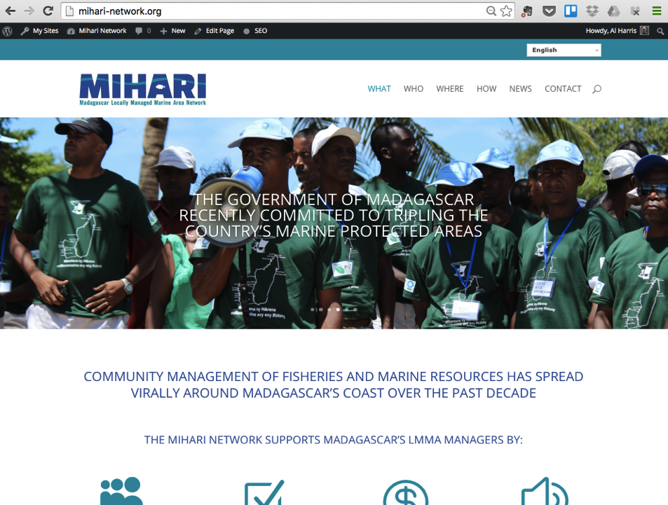

Slide 21
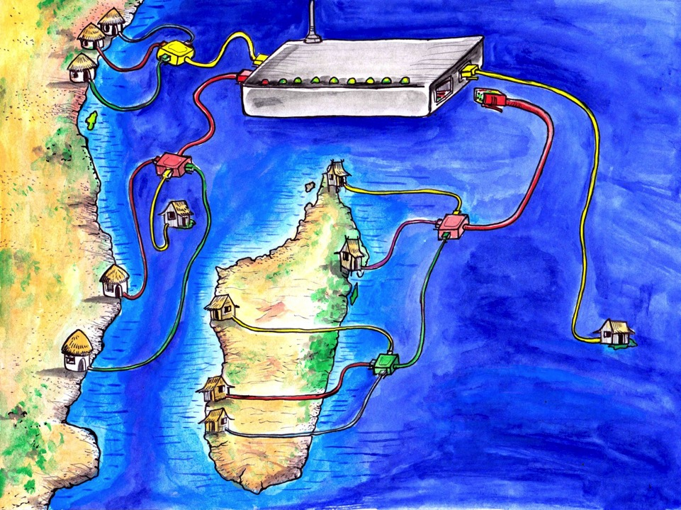

Slide 22
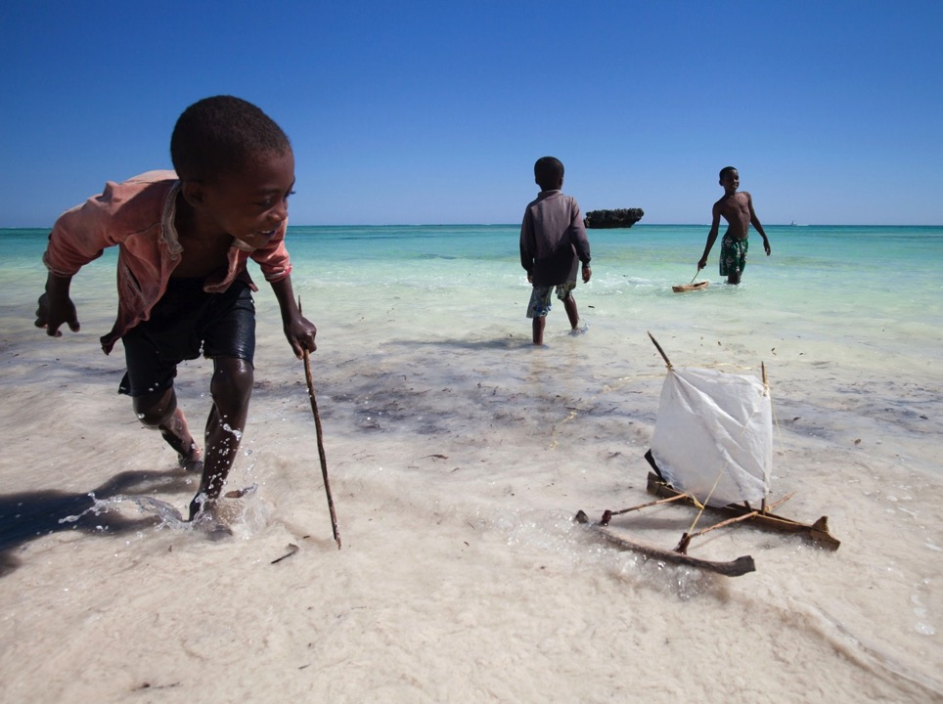
Thank you!

